Slide 1
Software Quality Engineering
Software Product Quality Metrics
Ms. Maheen Gul
Department of Computer Science
COMSATS University Islamabad, Islamabad Campus

Slide 2
Software Quality Engineering
BS(SE)-VI
“You can’t control what you can’t measure.”
Tom DeMarco (1962)

Slide 3
Objectives of software quality metrics
To assist management to monitor and control development and maintenance of software systems and their process improvements by:
Observing the conformance of software product to functionality and other requirements, regulations, and conventions.
Serving as a data source for process improvement by:
Identifying cases of low performance requiring improvement.
Demonstrating the achievements of process improvement proposals (corrective actions)
Notes:
quantifiable measures used to evaluate and track the performance of an organization, department, team, or individual.

Slide 4
The metrics’ required characteristics
In order for the selected quality metrics to be applicable and successful, both favorable metrics characteristics and metrics implementation characteristics are required.
The metrics characteristics include being relevant, valid, reliable, comprehensive, and mutually exclusive.
The three metrics implementation characteristics are: being easy and simple, not requiring independent data collection, and immune to biased intervention by interested parties

Slide 5
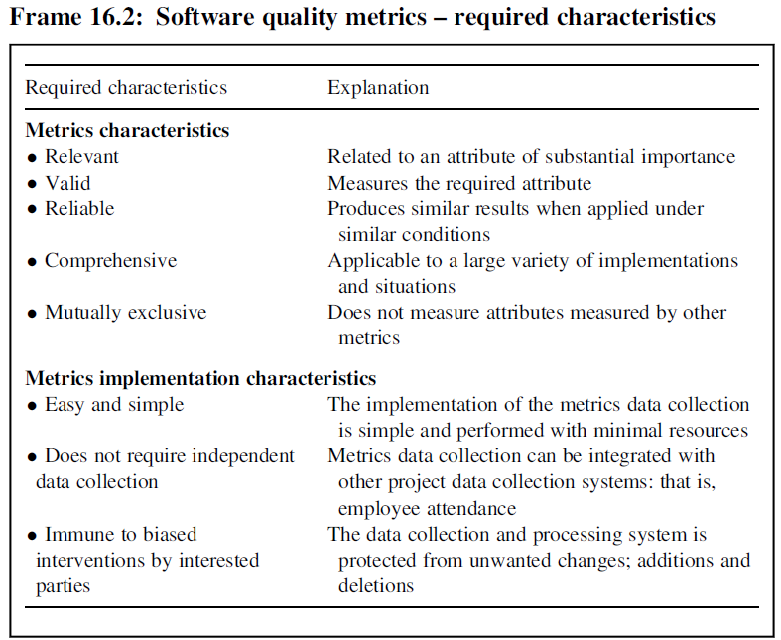
The metrics’ required characteristics

Slide 6
Implementation of software quality metrics
Several books, book chapters, and numerous journals as well as conference papers have been dedicated to the subject of software quality metrics.
A comprehensive presentation of software product metrics is provided by the four-part ISO/IEC Std. 9126 (ISO/IEC 2002–2004) (ISO/IEC, 2002).
The implementation of software quality metrics
Product metrics and their classification
Software product size metrics
Software attribute metrics

Slide 7
2. Product metrics and their classification
Software process metrics are a quantitative representation of software processes, as experienced by developers and maintainers throughout the software life cycle, such as, prerelease defects, percent of modified code lines, and density of detected defects.
Software product metrics are a quantitative representation of software products or intermediate product’s attributes, as experienced by the user when applying the software trying to adapt it or change it, such as size, effectiveness, productivity, and reliability
The product metrics are classified into two classes:
Software product size metrics
Software attributes metrics
Notes:
quantifiable measures used to evaluate and track the performance of an organization, department, team, or individual.

Slide 8
3. Software product size metrics
A measure of software product size is needed mainly:
to estimate the required development resources at the stage of preparing a proposal for a software project or planning and scheduling its process of development and
for use in other metrics when comparing the performance proportionally to the software project size, for example, in metrics of productivity, quality (defects rates), and so on.
Two approaches for software size metrics are offered:
Thousands Off Lines of Code (KLOC).
Function points (FPs).

Slide 9
3. Software product size metrics
Thousands Off Lines of Code (KLOC).
This metric represents metrics based on the physical completed size of software, such as the number of lines of code or the number of software statements. While the application of this metric is very simple, once the software project is completed, its application during the early stages of development is very inaccurate. Estimates of the expected KLOC size of a planned project rely only on the personal experience of the evaluators, and the impression they form when examining the project specifications

Slide 10
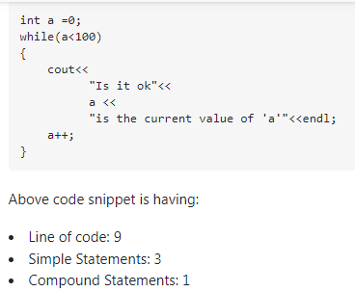
3. Software product size metrics
Thousands Off Lines of Code (KLOC).

Slide 11
3. Software product size metrics
Function points (FPs).
This metric represents the result of applying a measure from the group of functional size measurement (FSM) methods.
The FSM concept requires counting items such as inputs and outputs of software systems, software transactions, and logical file systems derived directly from the requirement specifications where the level of complexity/difficulty is evaluated for each item, and an adequate factor is defined accordingly.
• What is the average number of programming logical statements per function point?
• What is the average productivity of a staff member in terms of the number of function points produced per month?

Slide 12
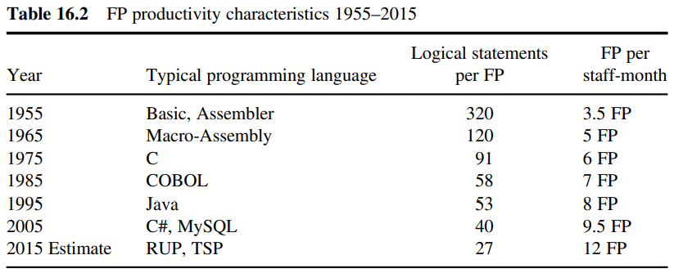
3. Software product size metrics

Slide 13
4. Software product attribute metrics
The ISO/IEC technical reports relate to 10 attributes of software products, which are as follows:
Software functionality
Software reliability
Software usability
Software efficiency
Software maintainability
Software portability
Software effectiveness
Software productivity
Software safety
Software satisfaction

Slide 14
Entities and Attributes
Attributes are characteristics or properties of entities.
E.g. a person (entity) can be described by characteristics such as height, colour of eyes, sex, IQ, age, and years of experience (attributes).
Software entities be described by attributes such as size, cost, elapsed time, effort expended, response time, transaction rates, number of defects found, and operational reliability.

Slide 15
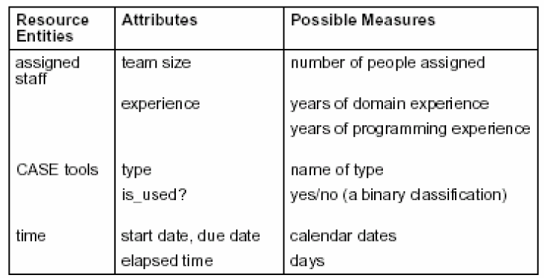
Resource Measures (Entities)

Slide 16
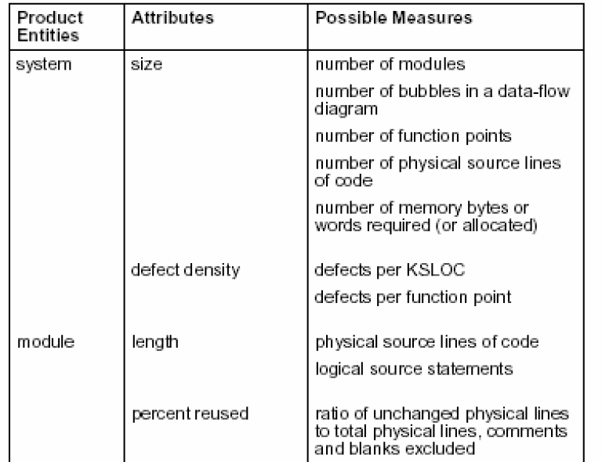
Product Measures (Entities)

Slide 17
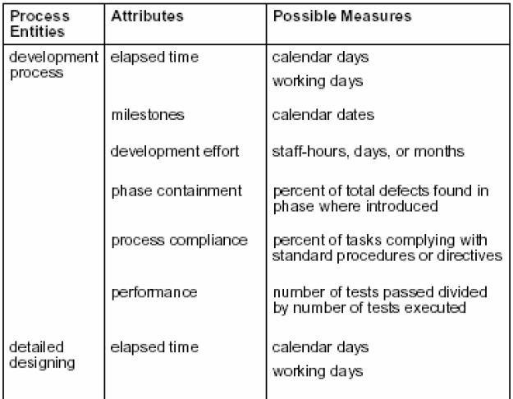
Process Measures (Entities)

Slide 18
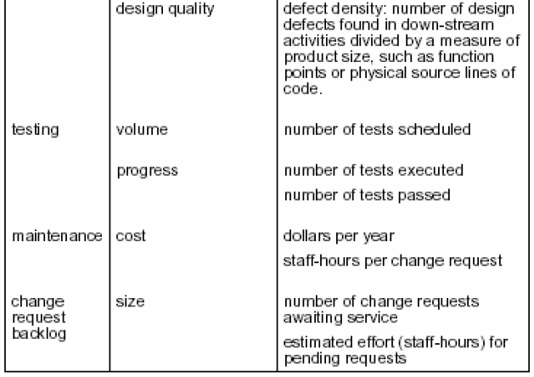
Process Measures (Entities)

Slide 19
Function-Oriented Metrics
The following Five information domain characteristics are determined:
Number of user inputs (External Input (EI))
Number of user outputs (External Output (EO))
Number of user inquiries (External Inquiry (EQ))
Number of files (Internal Logical Files (ILF))
Number of external files(External Interface Files(EIF))

Slide 20
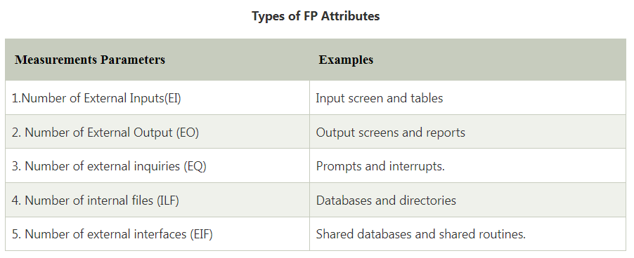
Function-Oriented Metrics

Slide 21
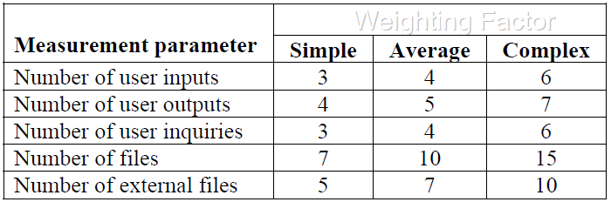
Function-Oriented Metrics –Weighting Factors
Once the data about information domain has been collected, a complexity value is associated with each count.
The complexity may be simple, average, or complex. A weighting factor is associated with complexity value as shown below:

Slide 22
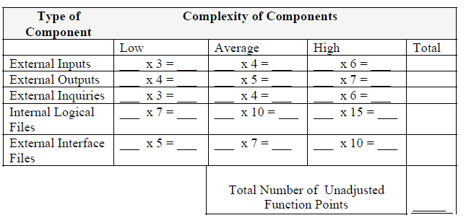
Function-Oriented Metrics –Weighting Factors

Slide 23

Function-Oriented Metrics –Weighting Factors
With the weighting factors, the first step is to calculate the function points (FCs) based on the following formula:
Where x_{i} is the counts for each of the five components and w_{ij} is the corresponding weighting factor.
The second step involves a scale from 0 (not important or applicable) to 5 (absolutely essential) to assess the impact of 14 general characteristics in terms of their likely effect on the application

Slide 24
Function-Oriented Metrics –Weighting Factors
The 14 General characteristics
Data communications (are data communications required?)
Distributed functions (Are there distributed processing functions?)
Performance (Is performance critical?)
Heavily used configuration (Will the system run in an existing, heavily utilized operational environment?)
Transaction rate
Online data entry
End-user efficiency
Online update
Complex processing
Reusability
Installation ease
Operational ease
Multiple sites
Facilitation of change

Slide 25

Function-Oriented Metrics –Weighting Factors
The scores (ranging from 0 to 5) for the above characteristics are then summed up, based on the following formula:
Where C_{i} is the score for general system characteristic i.
Finally, the number of function points is obtained using the following formula:
FP = Unadjusted Function Points× Value Adjustment Factor
FP = FC×VAF
Once function points have been calculated, they are used in a manner similar to LOC as a way to normalize measures for software productivity, quality, and other attributes.

Slide 26
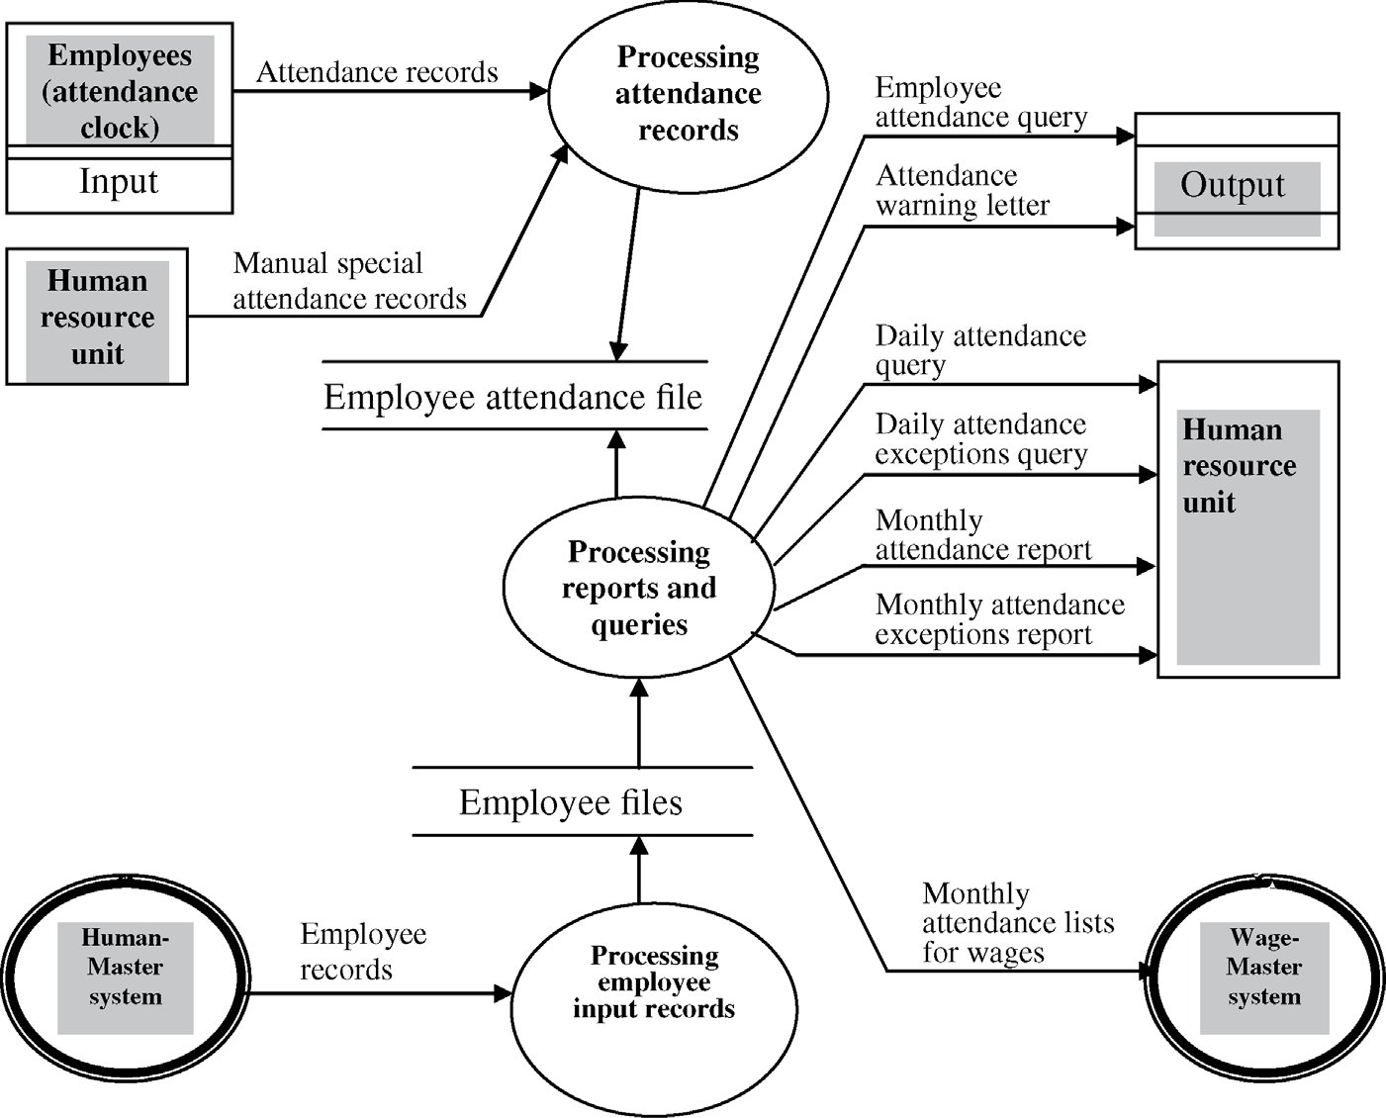
Functional Point Example 1

Slide 27
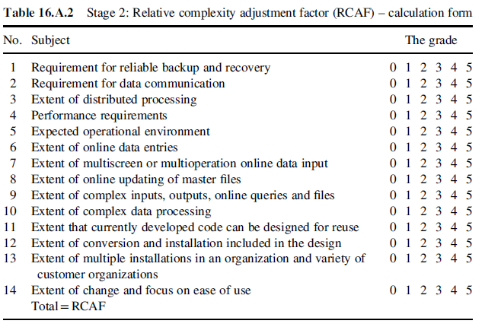
Functional Point Example 1

Slide 28
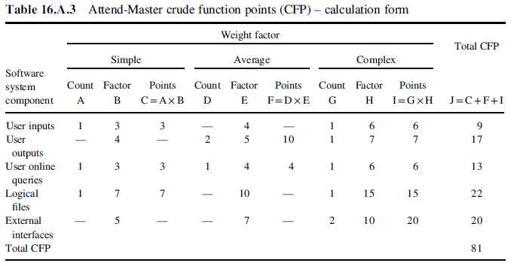
Functional Point Example 1

Slide 29
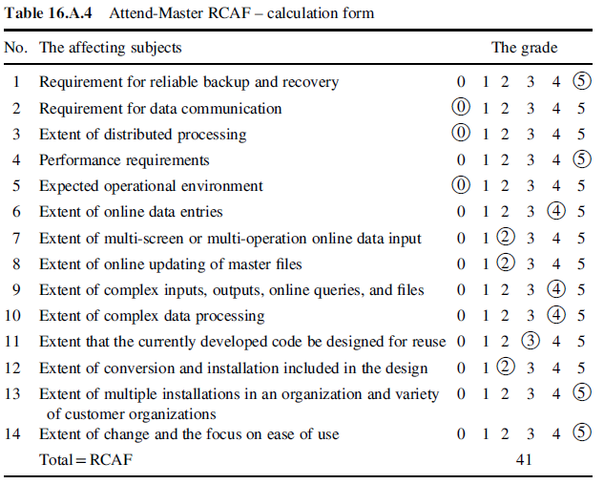
Functional Point Example 1

Slide 30
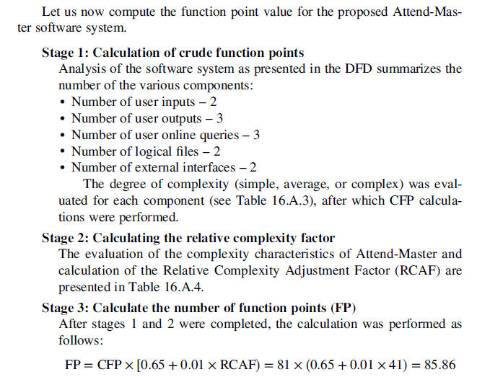
Functional Point Example 1

Slide 31
Functional Point Example 2
For the Given the following values, Compute Functional Point (F.P) when all complexity adjustment factors (CAF) and weighting factors are average.
Functional Unit | Values | Weighting Factor
 |  | Low | Average |  | High
User Input | 50 | 3 | 4 | 6
User Output | 40 | 4 | 5 | 7
User Enquires | 35 | 3 | 4 | 6
User File | 6 | 7 | 10 | 15
External Interface | 4 | 5 | 7 | 10

Slide 32
Functional Point Example 2
Step 1
Each Function Point is ranked according to complexity. There exists predefined weight for functional point in each category. In the above given data the weight of each functional point is average i.e. 4, 5, 4, 10 and 7.
Step 2
Calculate the unadjusted function point by multiplying each functional point by its corresponding weight factor

Slide 33

Functional Point Example 2
Functional Unit | Values | Weighting Factor
User Input | 50 | 4 | 200
User Output | 40 | 5 | 200
User Enquires | 35 | 4 | 140
User File | 6 | 10 | 60
External Interface | 4 | 7 | 28
Total |  |  | 628
Step 3
Calculate final function point
CAF= [0.65 + {0.01* (14*3 )}]
CAF = 1.07
Final F.P = FC * CAF
Final F.P = 628 * 1.07
Final F.P =671.96

Slide 34
Functional Point Example 3
Based on the FP measure of software many other metrics can be computed:
Errors/FP
$/FP.
Defects/FP
Pages of documentation/FP
Errors/PM.
Productivity = FP/PM (effort is measured in person-months).
$/Page of Documentation.
LOCs of an application can be estimated from FPs. That is, they are interconvertible. This process is known as backfiring. For example, 1 FP is equal to about 100 lines of COBOL code.
Notes:
Person-Month (PM): It represents the amount of work that one person can complete in one month.

Slide 35
Functional Point Example 3
Example: Compute the function point, productivity, documentation, cost per function for the following data:
Number of user inputs = 24
Number of user outputs = 46
Number of inquiries = 8
Number of files = 4
Number of external interfaces = 2
Effort = 36.9 p-m
Technical documents = 265 pages
User documents = 122 pages
Cost = $7744/ month
Various Weight Factors respectively are 4,4,6,10,5
Various processing complexity factors are: 4, 1, 0, 3, 3, 5, 4, 4, 3, 3, 2, 2, 4, 5

Slide 36
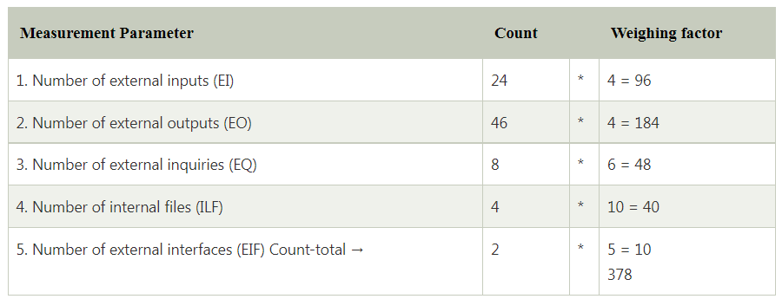
Functional Point Example 3

Slide 37
Functional Point Example 3
So sum of all f_{i} (i ← 1 to 14) = 4 + 1 + 0 + 3 + 5 + 4 + 4 + 3 + 3 + 2 + 2 + 4 + 5 = 43
FP = Count-total * [0.65 + 0.01 *∑(f_{i})] = 378 * [0.65 + 0.01 * 43] = 378 * [0.65 + 0.43] = 378 * 1.08 = 408

Slide 38
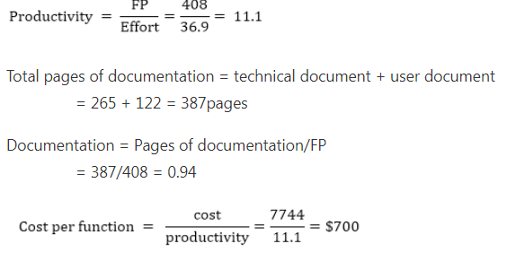
Functional Point Example 3

